Slide 1


Shield Insurance Customer Insights & Sales Analytics
Presented by : Ankush Patil

Slide 2
Strong Business Growth
Across the Reporting Period | Nov 2022 – Apr 2023
₹989M
Total Revenue
₹37K
Average Revenue per Customer
(ARPC)
27K
Total Customers
Revenue growth can be accelerated through Customer growth.

Slide 3
Revenue & Customer Growth
Monthly Trend | Nov 2022 – Apr 2023
📈 Key Insight
Revenue and Customer trend moved together, indicating balanced business growth.
⭐ Key Observation
March recorded the highest revenue and customer count, due to customers planning for tax savings.

Slide 4
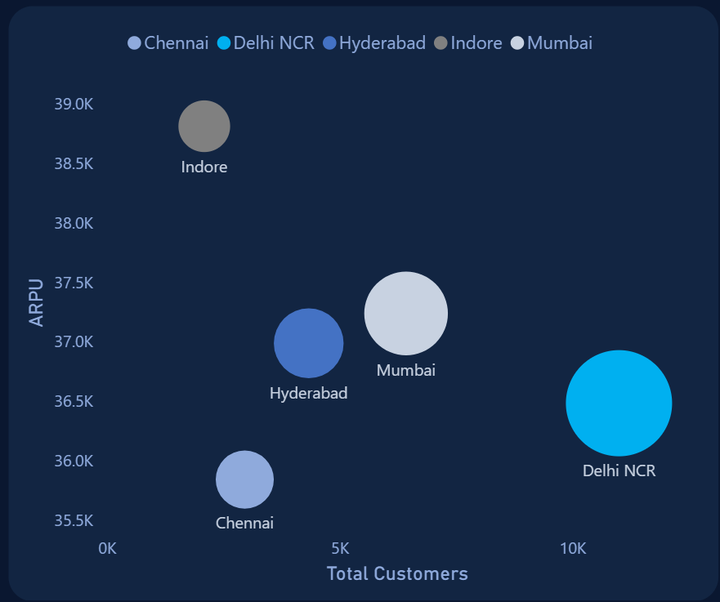
Delhi NCR drives the Largest Business Volume
City-Wise Analysis
Bubble size → Revenue
81M
📈 Key Insight
Delhi NCR generated the highest revenue and acquired the largest customer base, making it the company’s largest market by business volume.
Average Revenue per Customer (ARPC)
240M
161M
⭐ Key Observation
402M
ARPC remains relatively consistent across cities (~36k-39k), indicating that revenue differences are primarily driven by customer volume.
106M

Slide 5
31-40 Age Group leads Overall Revenue
Age-Group Analysis
📈 Key Insight
The 31–40 age group contributes the highest revenue (38%), supported by having the largest customer base.
⭐ Key Observation
Customers aged 31–40 form the largest customer base, likely driven by greater financial responsibilities such as family protection, home ownership, and long-term financial planning.

Slide 6
ARPC increases with Customer Age
Age-Group Analysis
📈 Key Insight
ARPC steadily increases with age, customers aged 65+ generating the highest revenue per customer.
Older customers often seek broader coverage and enhanced protection, contributing to higher average premiums.

Slide 7
Policy Preferences Shift with Customer Age
Top Policies
Age Group | Preferred Policy | Premium | Coverage
18-24 | POL4321HEL | ₹5K | ₹0.2M
25-30 | POL4321HEL | ₹5K | ₹0.2M
31-40 | POL3309HEL | ₹12K | ₹0.5M
41-50 | POL5319HEL | ₹17K | ₹0.8M
51-65 | POL9221HEL | ₹43K | ₹2.5M
65+ | POL2005HEL | ₹120K | ₹10M
📈 Key Insight
With increase in age, customers prefer policies offering broader coverage which results in increased premium and higher ARPC.
Premium : ₹5K → ₹120K (24x increase)
Coverage : ₹0.2M → ₹10M (50x increase)

Slide 8
Claim Settlement improves with Customer Age
Age Group Analysis
Settlement rate
38% → 74%
( +36 percentage points )
📈 Key Insight
Settlement rates increase steadily from 38% (18-24) to 74% (65+), indicating that older policy holders experience higher claim settlement rates.

Slide 9
Offline Agents drive the Highest Revenue
Sales Mode Analysis
📈 Key Insight
Offline Agents are the dominant sales channel, contributing over 55% of both customers and revenue.
⭐ Key Observation
Offline Agents remain the leading sales channel, likely driven by personalized guidance, stronger customer trust, and higher conversion rates.

Slide 10
Digital Channels Gain Momentum
Sales Mode Analysis
Monthly Sales mode Trend by Revenue
📈 Key Insight
Online App and Website channels show a consistent upward trend, reflecting increasing customer adoption of digital insurance purchases.
⭐ Key Observation
Improved convenience, 24/7 accessibility, and a seamless self-service experience helped digital channels surpass Offline Direct.

Slide 11

Target Policy Marketing by Age Group
Strategic Recommendations
Age Group | Marketing Focus
18-30 | Entry-level & Affordable policies
31-50 | Family protection & Health plans
51+ | Comprehensive & High-Coverage policies
Expected Outcomes
Higher marketing effectiveness
Improved policy conversion
Better customer satisfaction

Slide 12
Scale Customer Acquisition through Omnichannel Strategy
Strategic Recommendations
📱 Expand Digital Lead Generation
Increase investment in Online App and Website campaigns.
Focus on attracting younger (18-30 age), digitally active customers.
Expected Outcomes
📈 Higher Customer Acquisition
💰 Revenue Growth
⚡ Improved Sales Efficiency
🔄 Sustainable Long-Term Growth
🤝 Agent-Assisted Conversion
Route digital leads to Offline Agents for personalized consultation.
Preserve the high conversion advantage of offline agents.

Slide 13
Key Business Takeaways
👥 Customer Strategy
Customer needs evolve with age, making age-specific product positioning essential for maximizing policy adoption and customer value.
🌐 Channel Strategy
A digital-first, agent-assisted sales model can accelerate customer acquisition while preserving the high conversion strength of Offline Agents.
📈 Growth Strategy
Expanding successful acquisition strategies across markets can improve penetration and drive sustainable long-term revenue growth.

Slide 14
Thank you

